Slide 1
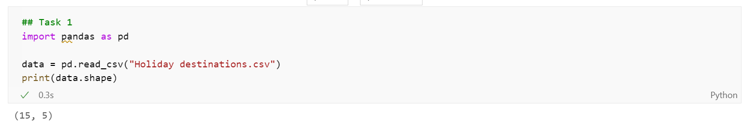
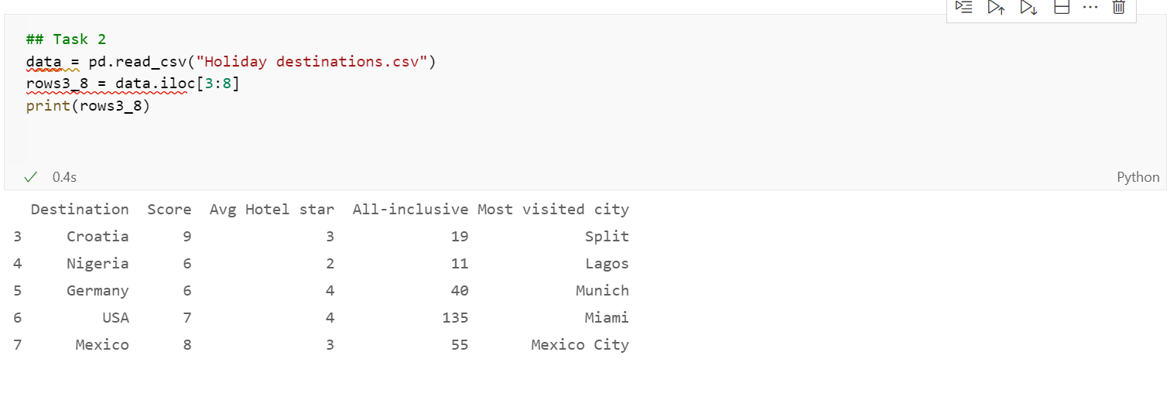
Holiday Destinations
As can be seen in the image above the csv file of holiday destinations contained 15 rows and 5 columns
I was then tasked with printing rows 3-8 which are seen in the image above

Slide 2
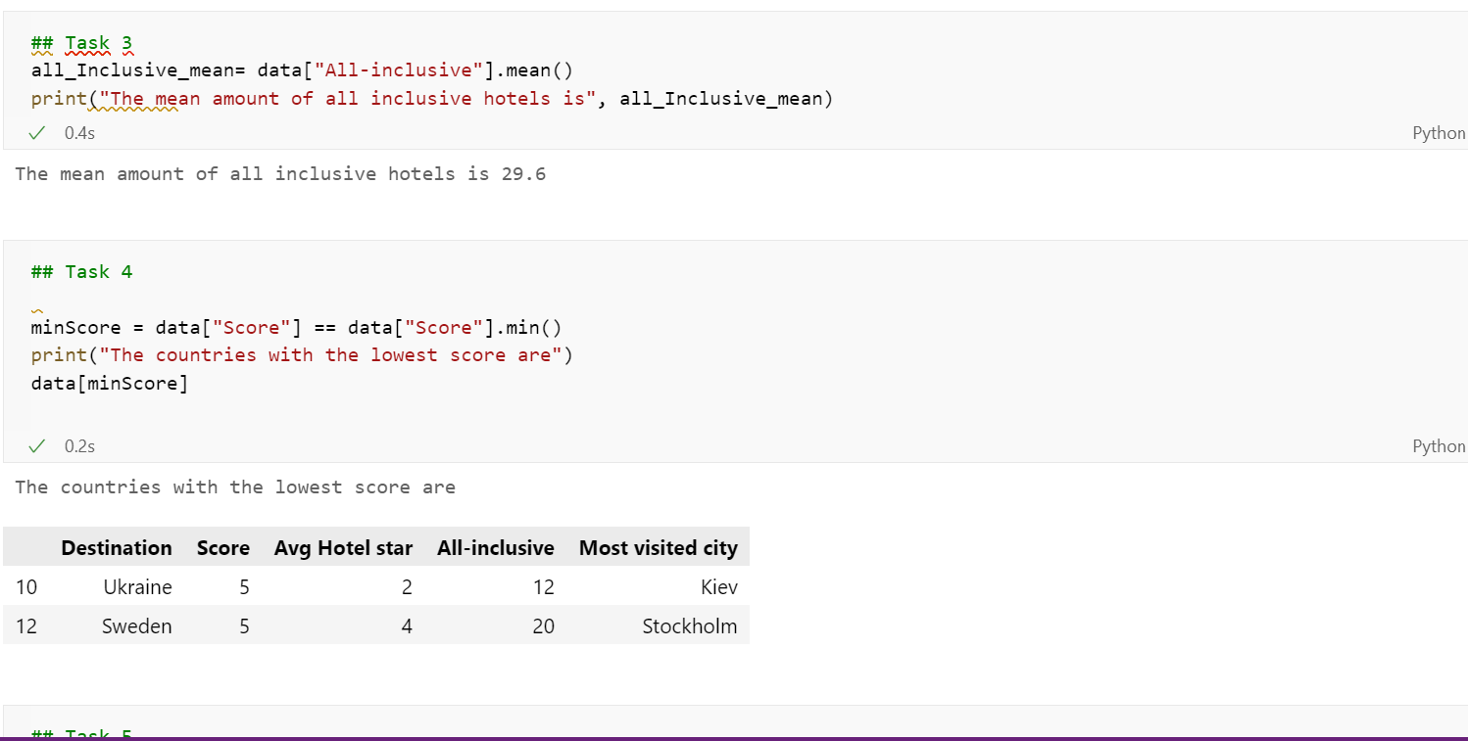
The next task was to find the mean number of all-inclusive hotels for the total group which was found to be 29.6
Task 4 shows the lowest scoring countries which turn out to be Ukraine and Sweden

Slide 3
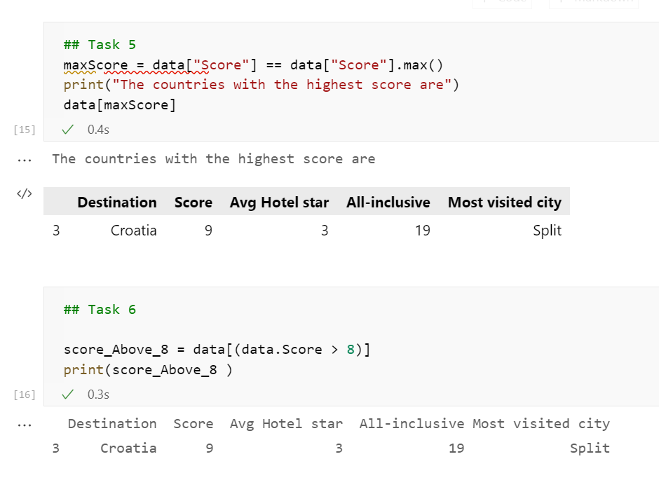
The next task was to find the highest scoring destination which was found to be Croatia with a score of 9.
After this I was tasked to find every destination with a score greater than 8, which was found to only be Croatia.

Slide 4
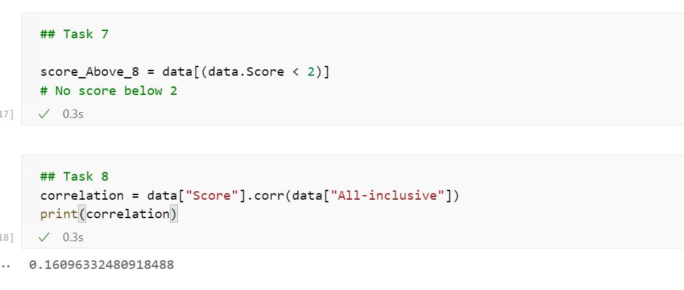
Task 7 was to find any destinations with a score below 2.However, no destination scored this low
Task 8 was an extension and was to find if there was any correlation between score and the amount of all inclusive hotels. The correlation was found to be 0.161 which suggests a slight positive correlation.

Slide 5
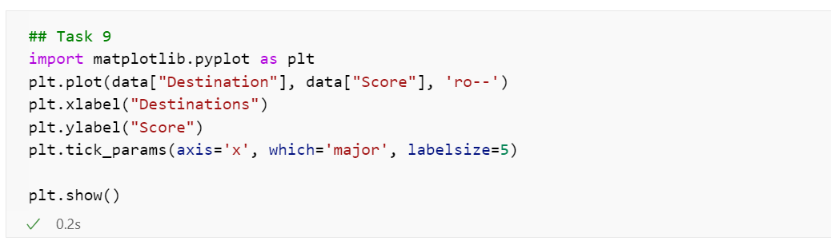
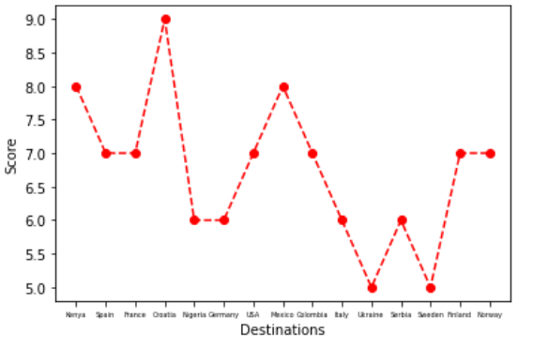
The final task was to plot a graph of the destinations and the corresponding scores and below is the following graph

